Slide 1

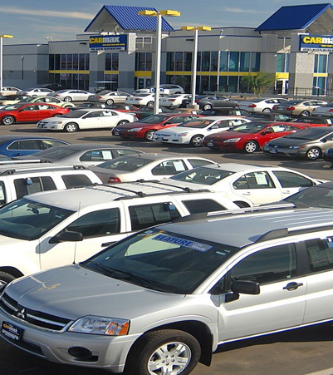
Old car price Prediction Project
By
Anshul Dubey

Slide 2

TABLE OF CONTENTS
Abstruct
Introduction
Problem Statement
Conceptual Background of the Domain Problem
Data Sources and their formats
About The DataSet
Data Preprocessing
Hardware and Software Requirements and Tools Used
selected models
Accuracy score of the model
Parameter tuning
Final model
Visualizations
Interpretation of the Results
Conclussion

Slide 3
Abstruct
A car price prediction has been a high-interest research area, as it requires noticeable effort and knowledge of the field expert. Considerable number of distinct attributes are examined for the reliable and accurate predictions. To build a model for predicting the price of used cars, we applied many machine learning techniques (Linear Regression, Support Vector Machine ,DTC,Random Forest,etc). The data used for the prediction was collected from the web portal www.olx.in using web scraper that was written in python programming language. Respective performances of different algorithms were then compared to find one that best suits the available data set. The final prediction model was integrated into Java application. Furthermore, the model was evaluated using test data and the accuracy of 99.0% was obtained

Slide 4
Introduction
Thousands of cars are sold everyday. There are some questions every buyer asks himself like: What is the actual price that this car deserves? Am I paying a fair price?
In this paper, a machine learning model is proposed to predict a car price based on data related to the car (its brand, the year it was built in, owner,fuel type,etc.). This will facilitate the reproducibility of our work. In this study, Python programming language with a number of Python packages will be used.

Slide 5
Problem Statement
A car is not only a symbol of social status but also a valuable asset. In 2018-19, while new car sales were recorded at 3.6 million units, 4 million second-hand cars were bought and sold, according to a recent report on India's pre-owned car market by Indian Blue Book, a used car pricing guide by Mahindra First Choice Wheels. The growth rate of new car sales has slowed owing to a variety of reasons, including cyclical slowdown in auto sales in election years and an overall consumption slowdown in the economy. New car sales grew 2.70% in 2018-19, the slowest growth rate for the industry in four years. In April, passenger vehicle sales saw a sharp decline compared with the same month last year, and domestic sales saw a contraction of 17.07%.People buy used cars for various reasons like to learn how to drive, to have a business car, to have a seperate car for work, financial crunch, selling the old car to get a new one and the reasons can be endless .The value of a car depreciates significantly in the first year itself, up to 50% for some models .From a buyer's perspective, the aspiration of owning a car is getting fulfilled at a lower price point. According to the Indian Blue Book report, 45% of the buyers want a car that is four to five years old. However, 46% of the sellers want to sell their vehicle when it is six to eight years old. Getting your used car insured will cost you a lot less as compared to a new car.

Slide 6
Conceptual Background of the Domain Problem
we are going to work on a dataset which consists information about the car, price. When we work on these sorts of data, we need to see which column is important for us and which is not. Our main aim today is to make a model which can give us a good prediction on the price of the car based on other variables. We are going to use Linear Regression for this dataset and see if it gives us a good accuracy or not.

Slide 7
Data Sources and their formats
I have scraped the old car data from olx and car dekho.com. The dataset contains 6224 rows and 10 columns having both numerical and categorical data.
In this dataset " car Price" is our target variable which has float values. So this is a "Regression type" problem.
you can download the dataset from the below link.
Dataset link:
https://github.com/anshuld1995/internship/tree/main/CarPricePrediction_

Slide 8
About The DataSet
'Model’
'Make_Year’
'Driven_Kilometers'
'Fuel’
'Transmission’
'Owner(s)’
'Mileage’
'Engine’
'Price’
'Location

Slide 9
Data Preprocessing
For the purpose of the project the dataset has been preprocessed as follows:
• we divide all the columns into categorical and numerical types
• Univariate Analysis Of Categorical Columns and numerical columns.
• Checking correlation with target column using Heatmap
• Checking skewness of each columns
• Handling missing value
• Checking Outliers and removing outliers by zscore
• Encoding the categorical column by Label Encoder
• Dividing data into features and vectors
• Checking VIF score
• Removing skewness by power transform method
• Standardizing the data by standard scaler

Slide 10
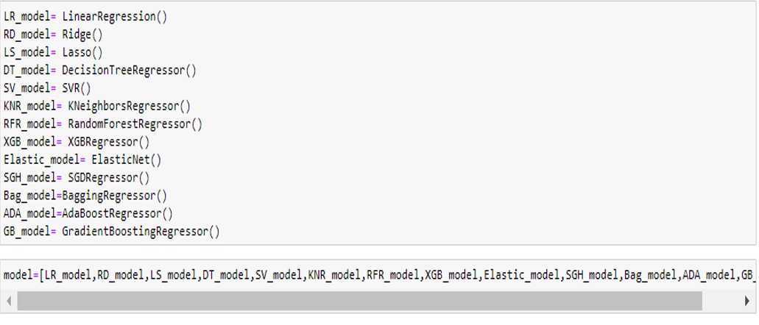
selected models
I used 13 different regression algorithms to get the ideal one for prediction

Slide 11
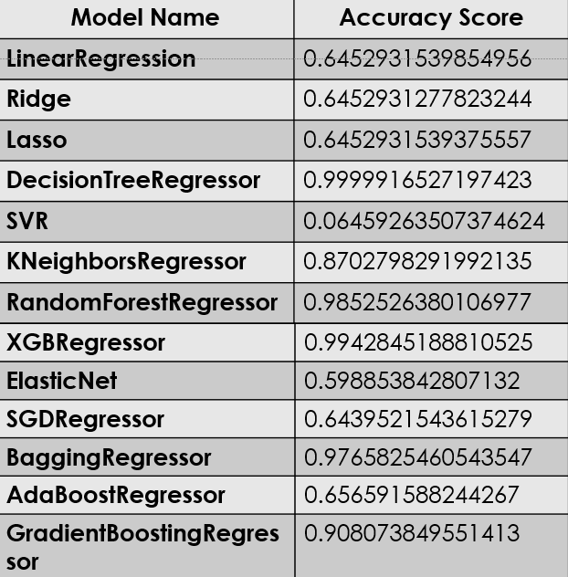
I used 13 different regression algorithms to get the ideal one for prediction

Slide 12
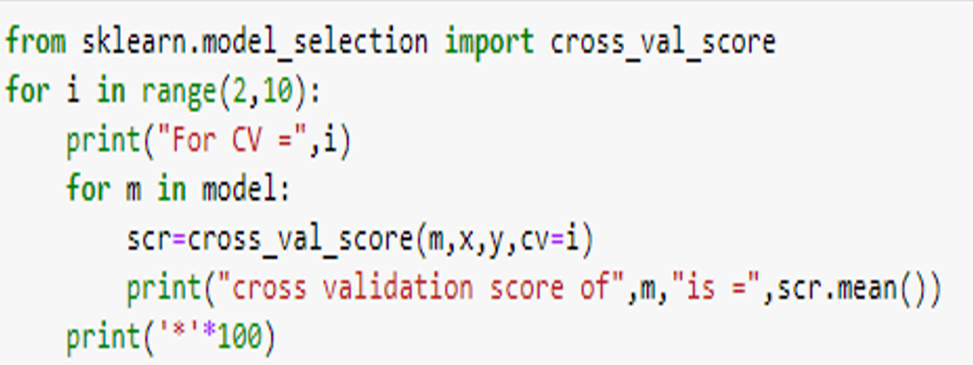
Cross Val Score

Slide 13
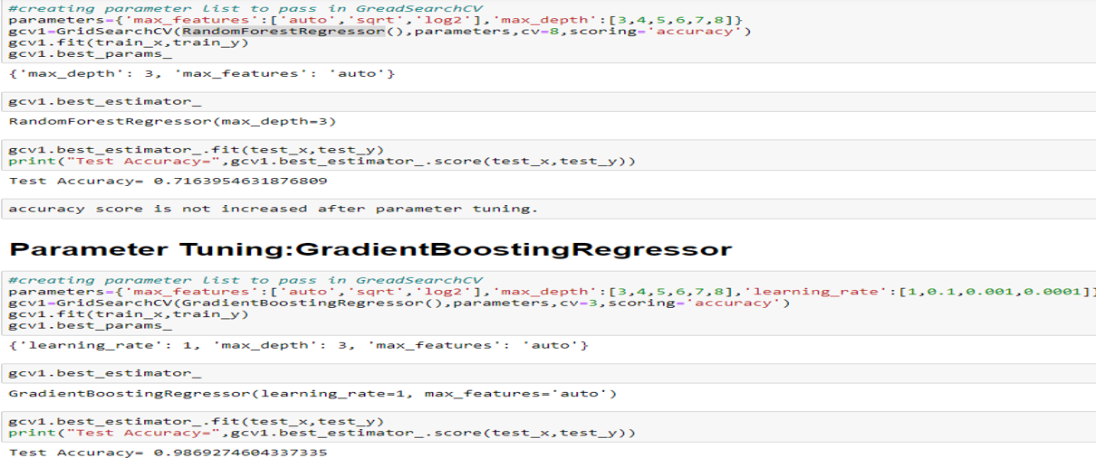
Parameter tuning
accuracy score has decreased after parameter tuning RandomforestRegressor and increased for GradientBoosting Regressor. Now we will create final model with this GradientBoosting Regressor parameter.

Slide 14
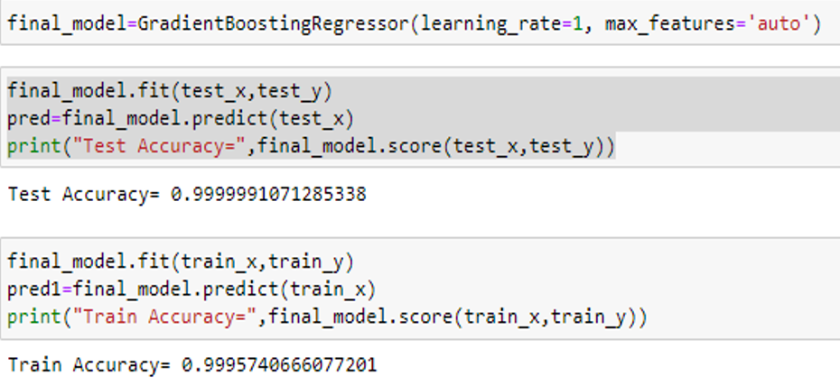
Final model

Slide 15
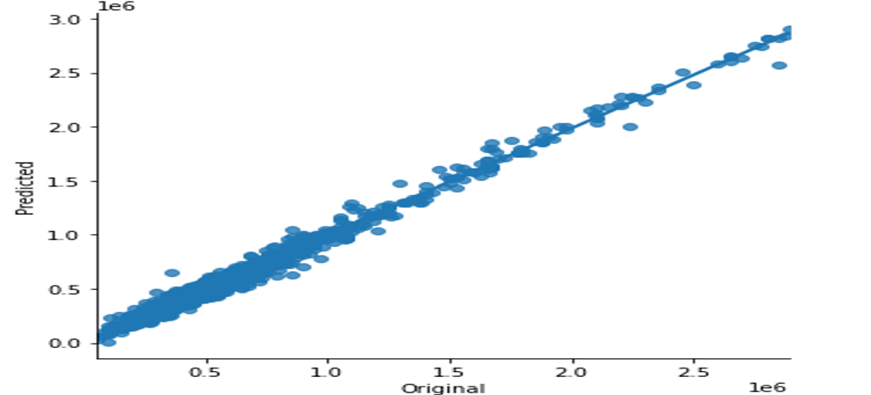
Visualizations
We can see that the original house price and final model’s predicted price are almost same which means model performance is good.

Slide 16
Interpretation of the Results
This particular problem needs a good vision on data, and in this problem Feature Engineering is the most crucial thing.
You can see how we have handled numerical and categorical data and how we build different machine learning models on the same dataset.
It is always advised to all of us that atleast we need to use 5 Algorithm in order to figure out which one is performing best among them and we choose that one and we send that for hyper parameter tuning to know that best parameter .
Using hyper parameter tunning we can improve our model accuracy, for instance in this model the accuracy increased.

Slide 17
Conclussion
When predicting car prices, many complications were involved. There are many variables / attributes to consider in determining the price of a car and if all or most of them are used, we need a lot of calculating power to get the price of the car. And it is very difficult to accurately predict car prices in real life.
For any of machine learning project my suggestion is first you have to understand the problem on ground level .if you don’t allow yourself to work with diligence .if you don’ t work harder anything that you are doing or will do , not only in case of machine learning but also in life cycle would be futile. Maybe, my endeavour assist you when ever you will get stuck

Slide 18
THANK YOU

